Slide 1
Infusing Sustainability Concepts into Mathematics and Statistics Courses
Megan Heyman, PhD (heyman@rose-hulman.edu)
Associate Professor, Statistician
Rose-Hulman Institute of Technology
IN MAA Fall Meeting, October 3, 2026

Slide 2
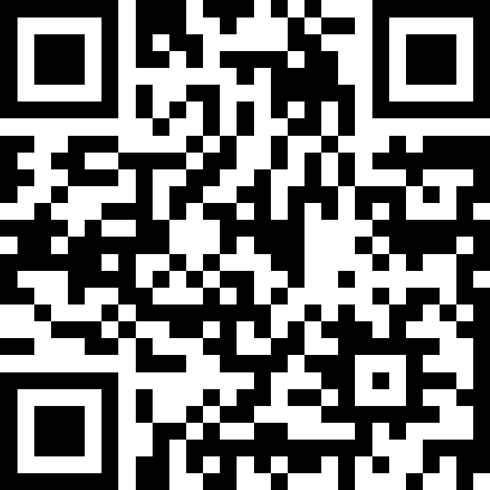
Audience Polls
I’ll seek audience thoughts and opinions a couple times during this seminar. I invite you to participate if you feel comfortable.
join at
slido.com
#1567 844

Slide 3
Do not edit
How to change the design
How would you describe your expertise in concepts of sustainability and SDGs?
The Slido app must be installed on every computer you’re presenting from

Slide 4
What to expect
What is sustainability and what are SDGs? (10-15 minutes)
How I’ve brought sustainability into my introductory statistics course (15-20 minutes)
Student sentiments from my classes (5-10 minutes)
Discussion of what works well and potential challenges with bringing sustainability into mathematics content.

Slide 5
Sustainability & SDGs

Slide 6
Sustainability (noun)
Cambridge Dictionary:
the quality of being able to continue over a period of time
the idea that goods and services should be produced in ways that do not use resources that cannot be replaced and that do not damage the environment
the ability to continue at a particular level for a period of time
Brundtland Commission 1987:
meeting the needs of the present without compromising the ability of future generations to meet their own needs.

Slide 7
Dimensions of Sustainability
Environment: all systems that support life on Earth
Social: areas such as health, influence, competence, impartiality and meaning-making
Economic: development and growth
Social
Sustainability
Economic
Sustainability
Society
Social
Environment
Economic
Environment
Economic
Environment

Slide 8
Sustainable Development
Sustainability is often viewed as a long-term goal.
The processes and pathways achieve sustainability are referred to as sustainable development.
In 2015, all UN member states adopted the 2030 Agenda for Sustainable Development.
“a shared blueprint for peace and prosperity for people and the planet, now and into the future”

Slide 9

17 SDGs

Slide 10
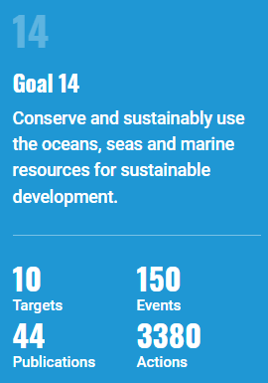
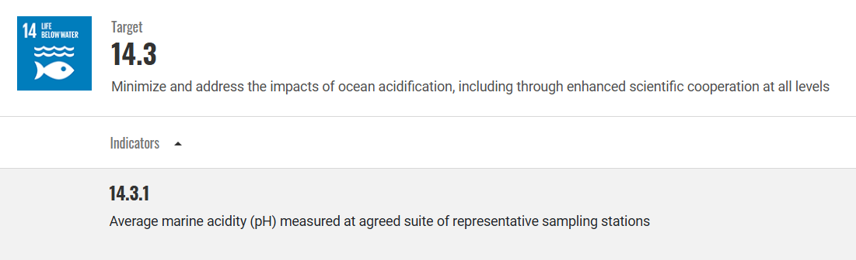
Example: SDG 14
Current progress on Target 14.3:
As the global average ocean surface pH declines, as a result of rising CO2 emissions and absorption by the ocean, acidification increases. The expansion of monitoring stations (from 178 in 2021 to 906 in 2026) highlights a growing capacity of countries to observe ocean pH. Despite this increase in observations, monitoring remains patchy, hindering the development of strategies for mitigation and adaptation at relevant scales.

Slide 11
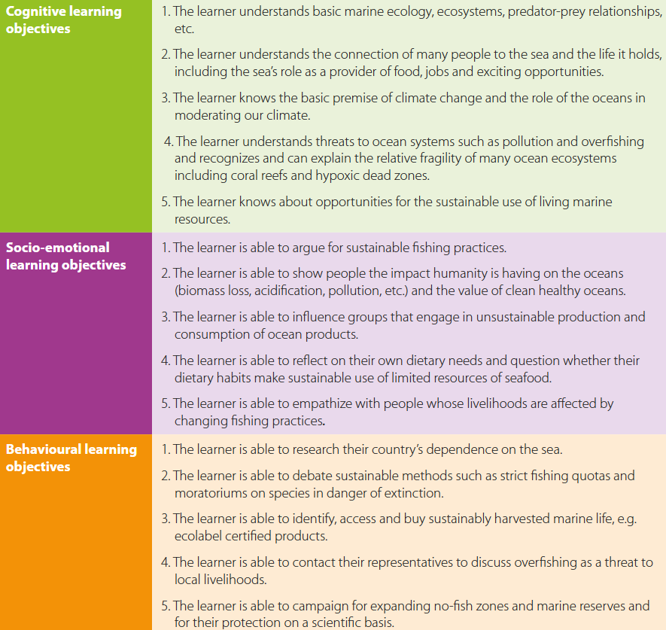
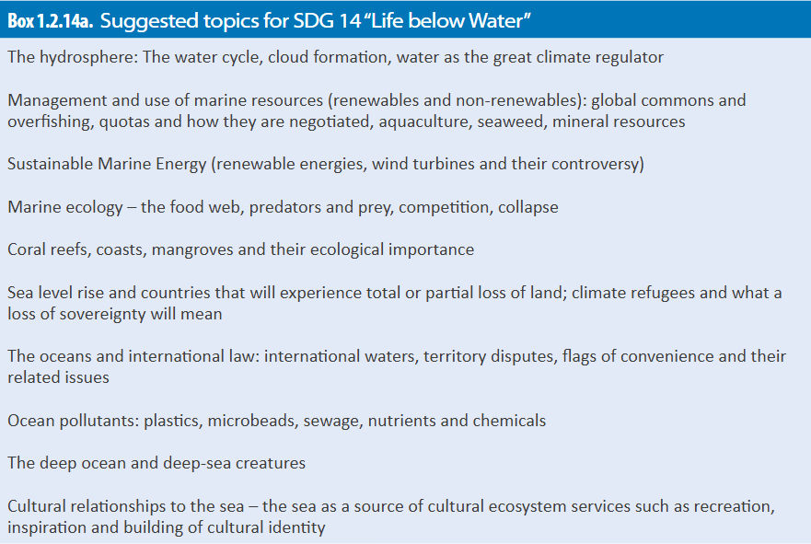
Example: SDG 14 Teaching Resources
Learning Objectives
Topics

Slide 12
Mathematics Education + Sustainability
A couple math-specific resources that might be helpful
Mathematics for Sustainability
(https://math-for-sustainability.com)
Sustainability Education: The What and How for Mathematics
(https://doi.org/10.1080/10511970.2013.834526)

Slide 13
SDGs in Introductory Statistics

Slide 14
Introductory Statistics (MA223)
Audience
Undergraduate STEM majors, often Y2
Required for ~60% of students
Often, a terminal course in statistics
Topics
Graphs & summary statistics
Inference for a population mean
1- and 2- way ANOVA
Simple linear regression
Traditional & nonparametric inference approaches
Hybrid format (50% asynchronous, online)

Slide 15
Typical In-Person Meeting Format
Before the meeting, asynchronous
~5 min. intro. video
Download (or print) notes packet, access data, helper code
During the meeting
~30 min. instruction
~20 min. group activity assessment
After the meeting, asynchronous
~10 min. optional auto-graded quiz in LMS

Slide 16
Group Activity Assignments
Incorporate GAISE recommendations
4) Integrate real data with a context and purpose throughout the course. Select data that are meaningful and engaging to the students.
8) Employ evidence-based pedagogies that actively engage students in the learning process.
9) Use a variety of formative and summative assessments to improve teaching and learning.
Just-in-time, formative assessment of course material.
20 in-person meetings = 20 group activities.

Slide 17
Group Activity Logistics
Group formation
Based on table students choose to sit at.
Tables contain 3-5 students.
Same group throughout the term.
Assessment (low-stakes, formative)
Submit (via LMS) one solution per group containing work completed by the end of the meeting.
Credit awarded for active participation and diligent effort.
Receive in-time feedback from instructor and a full set of solutions.

Slide 18
Infusing Sustainability
Breadth (several topics) vs. Depth (1-2 topics)
Big (overhaul course) vs. Small (sprinkle in)
Updated 10 of the group activities with an application related to sustainability
Introduce 8 of the SDGs
Support a cognitive learning objective for the SDG.
Support at least one course learning objective.
Provide opportunity to
Use real data to illustrate challenges associated with achieving the SDG while providing relevant applied statistics experience.
Empower students to learn more, reflect on their behaviors, and get involved/take action.

Slide 19












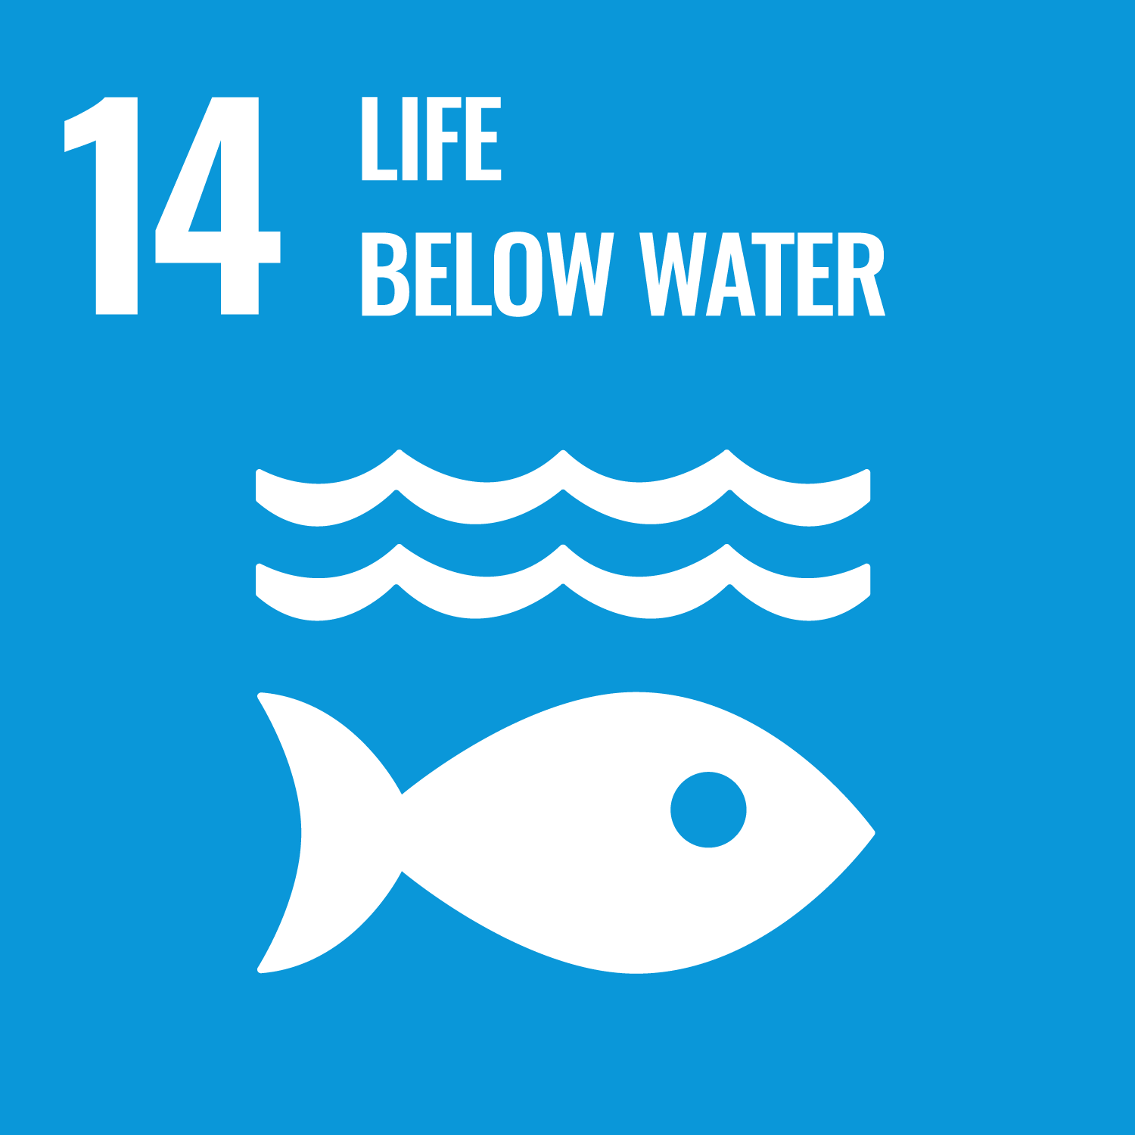





Sustainability Activity Applications
Statistical summary
Calculate your ecological footprint to make a dataset.
Summarize and visualize relationships among ecological footprint, flight travel habits, and food consumptions habits in MA223 students.
Bootstrapping (univariate)
On average, how many measles cases do we expect to happen per U.S. state, per year, given recent trends?
One-Way ANOVA
Given recent trends, is there evidence that the average yearly CO2 emissions per capita differs for at least one income classification of countries?
Sampling Distribution
Discuss dependence among yearly unemployment rates.
Confidence Intervals
Quantify how the average very low food security rate in Vigo Co. compares to elsewhere in the U.S.
Two-Way ANOVA
Describe design components of
A study relating coral reef vitality to ocean water acidity
A study of microplastics founds in oceans, globally.
Hypothesis Tests
Estimate the average yearly number of involuntary servitude offenses for U.S. border states.
Linear Regression
Describe how global average temperature has changed over time.
Describe the relationship between average global temperature and average global CO2 levels, over time.

Slide 20
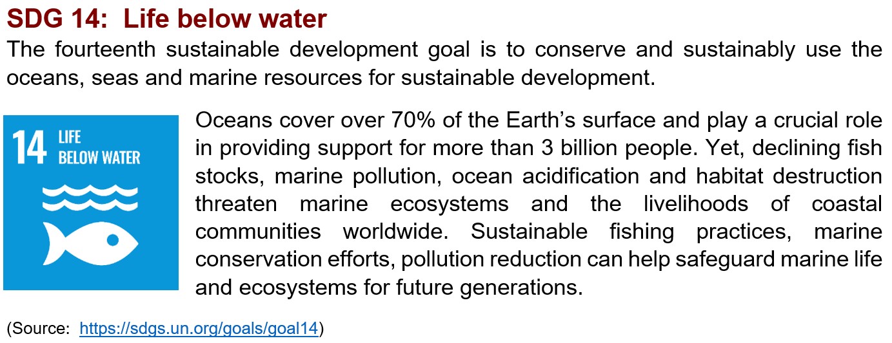
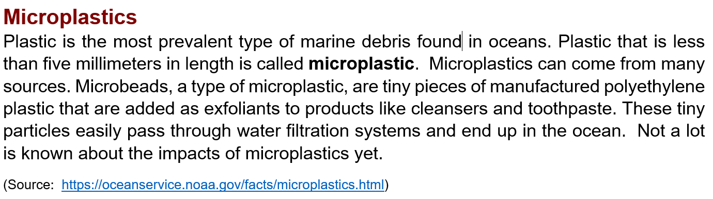
Example Activity Structure
Introduce the relevant SDG
Provide definition(s) for the topic

Slide 21
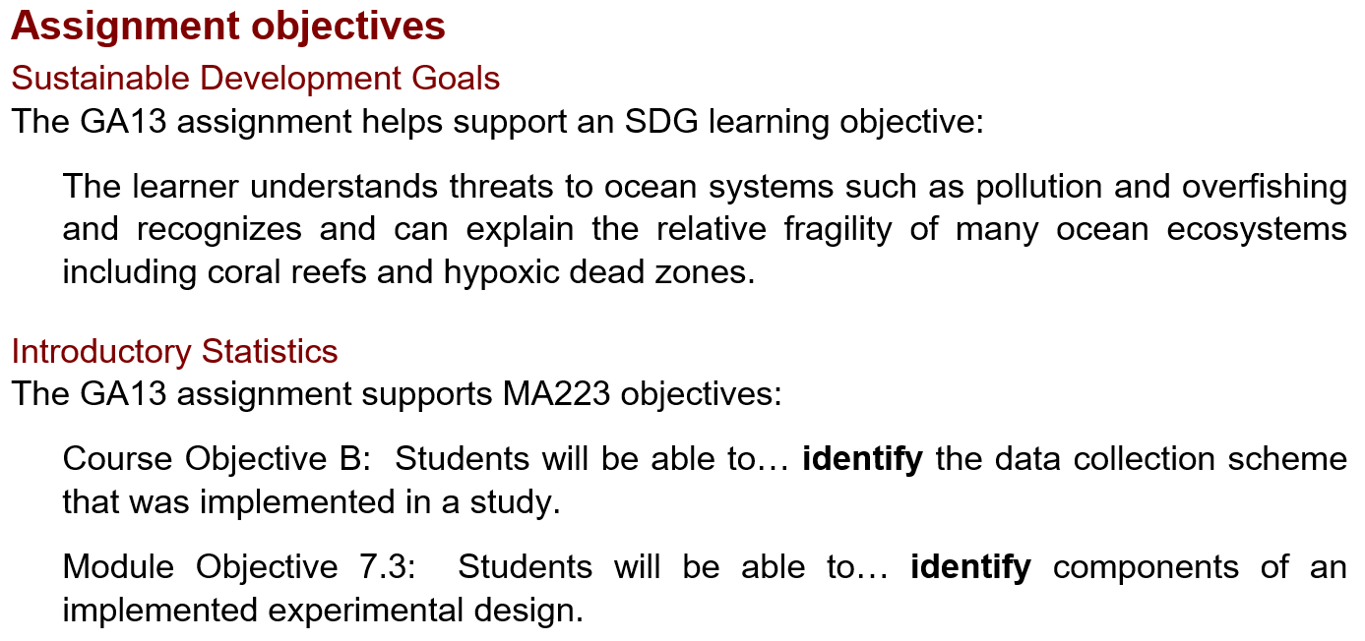
Example Activity Structure (cont.)
Relevant course & SDG learning objective(s)

Slide 22
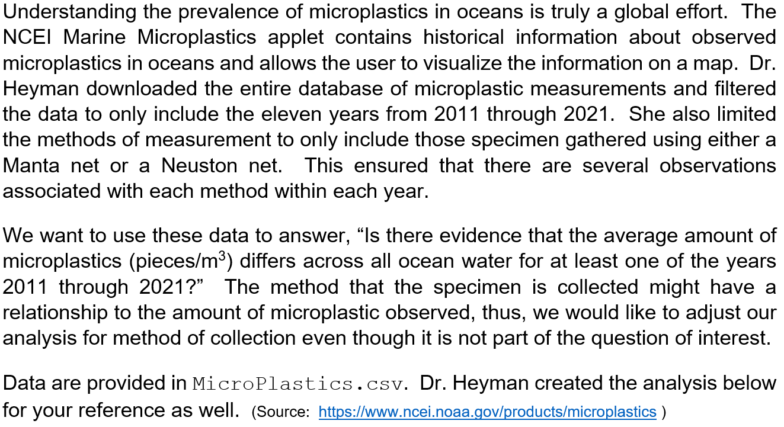
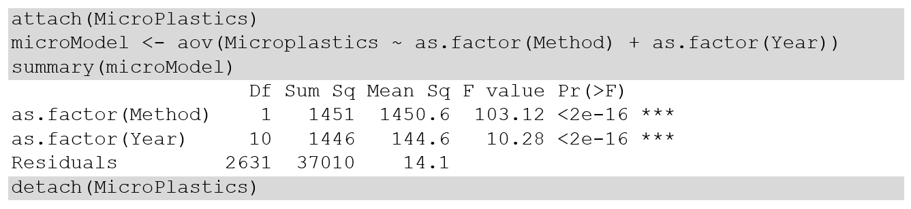
Example Activity Structure (cont.)
Scenario

Slide 23
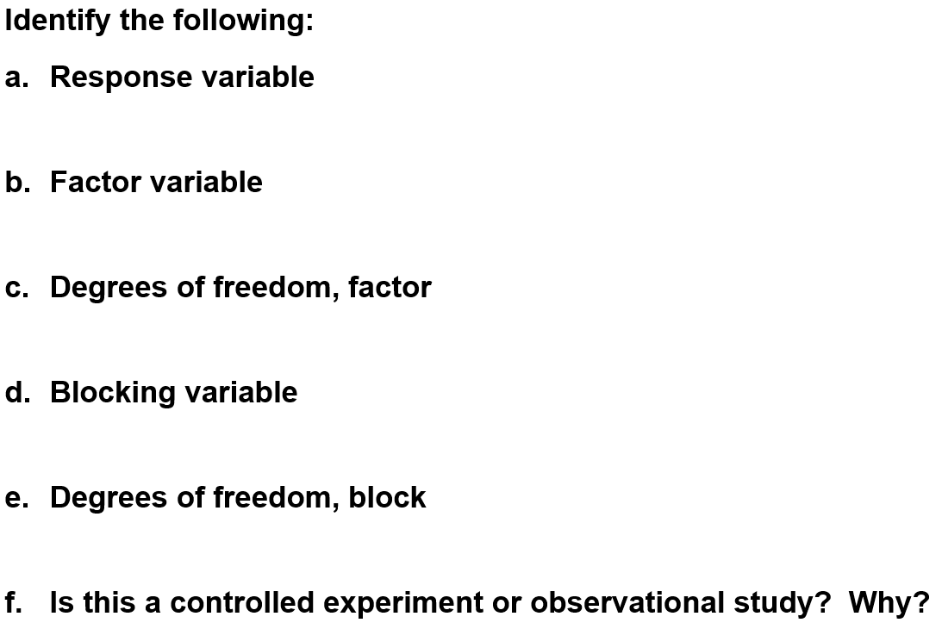
Example Activity Structure (cont.)
Questions students answer

Slide 24
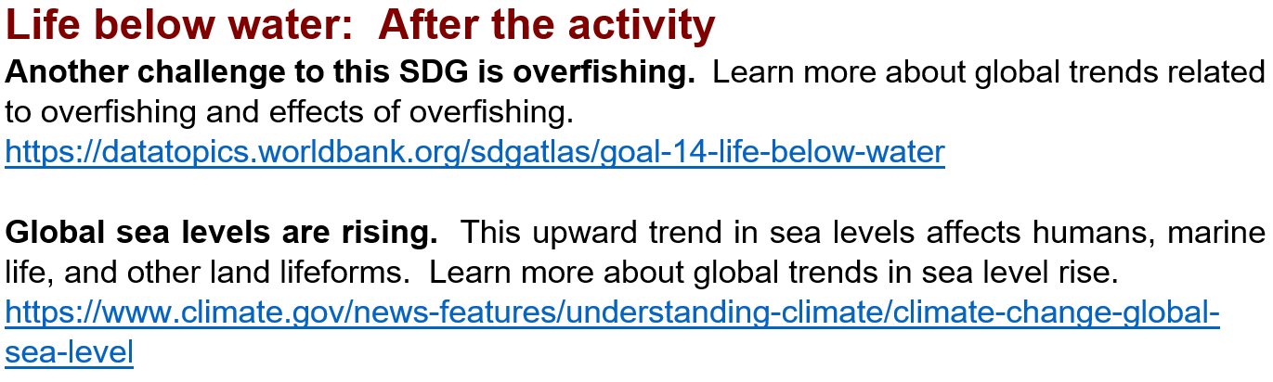
Example Activity Structure (cont.)
Additional information about the SDG
Appendix 1: Reminder definitions of sustainability, SDGs
Appendix 2: Why sustainability in a statistics course

Slide 25
Student Survey Results

Slide 26
Sustainability Teaching Network
Thank you to the STN leadership at Rose-Hulman:
Dr. Rebecca DeVasher, Dr. Mark Minster, Dr. Jenny Mueller
Thank you to my STN cohort faculty peer mentor:
Dr. Eric Reyes
Rose-Hulman Strategic Plan
Theme: Infuse Sustainability into Rose-Hulman Education
and Culture
This work is associated with human subjects research protocol IR# RHS0436.

Slide 27
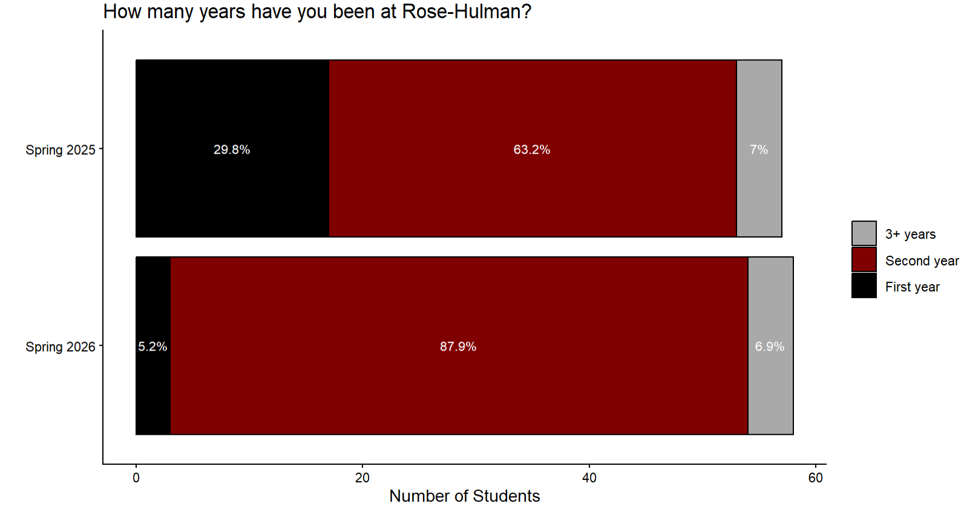
Student Survey: Respondent demographics
Two terms with 3 sections each term.
Overall response rate: 82% (115/140)
 | Response | Engineering Major
Spring 2025 | 84% (57/68) | 91% (52/57)
Spring 2026 | 81% (58/72) | 93% (54/58)

Slide 28
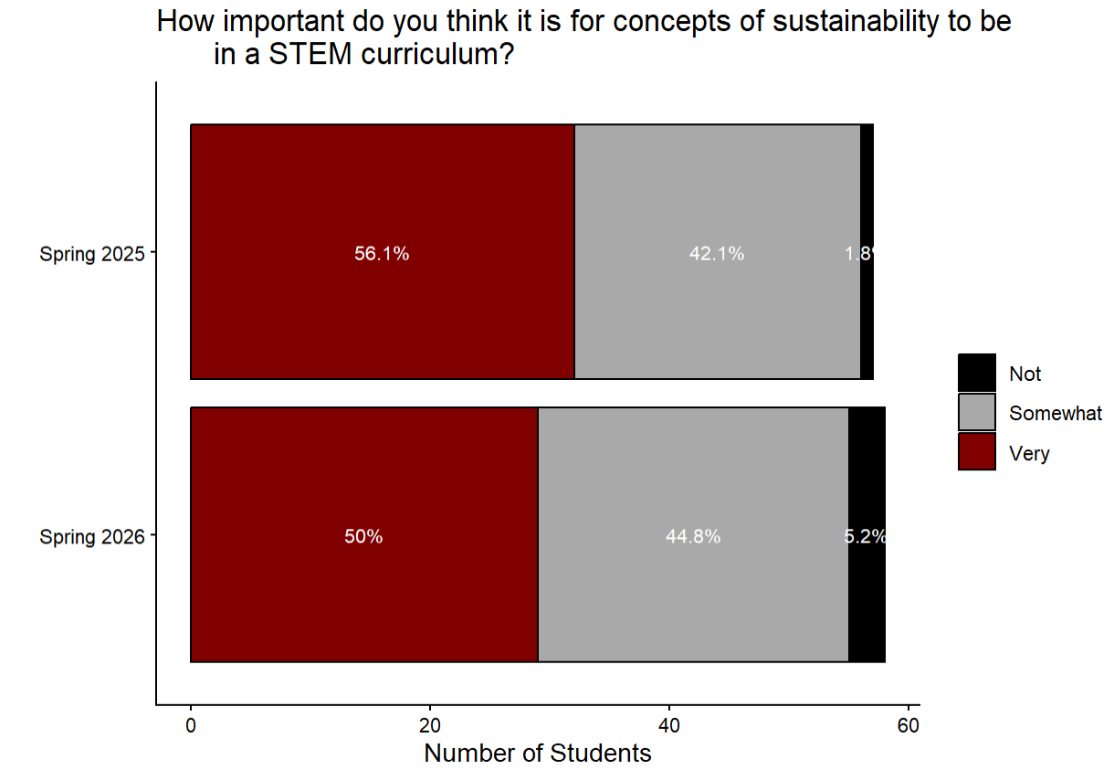
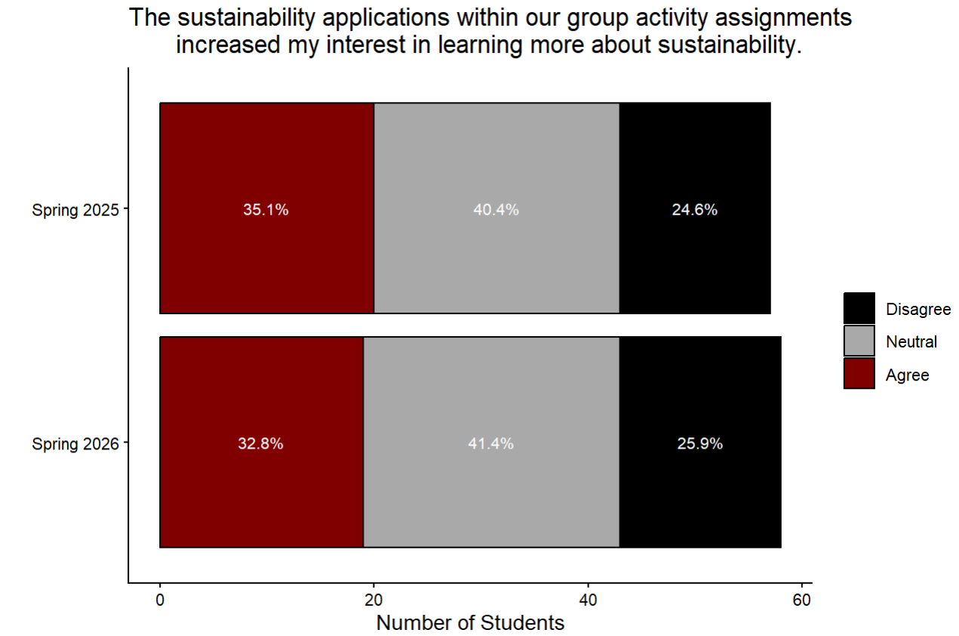
Student Survey: Sentiments
Students generally find sustainability as an important topic.
Activities aren’t drastically changing interest to learn more.

Slide 29
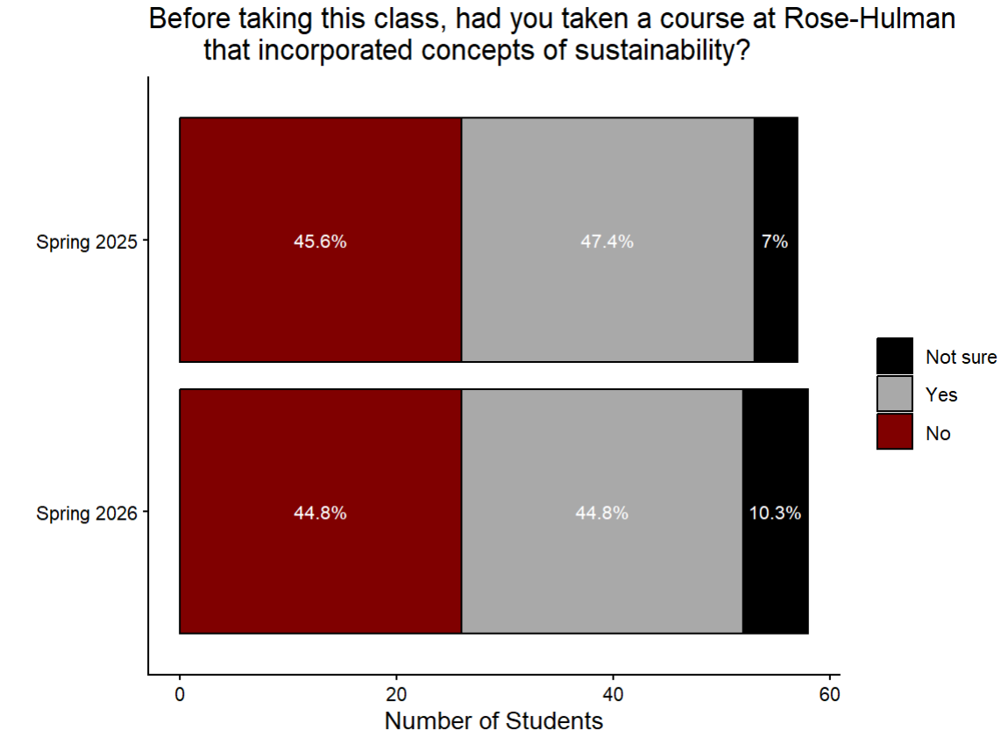
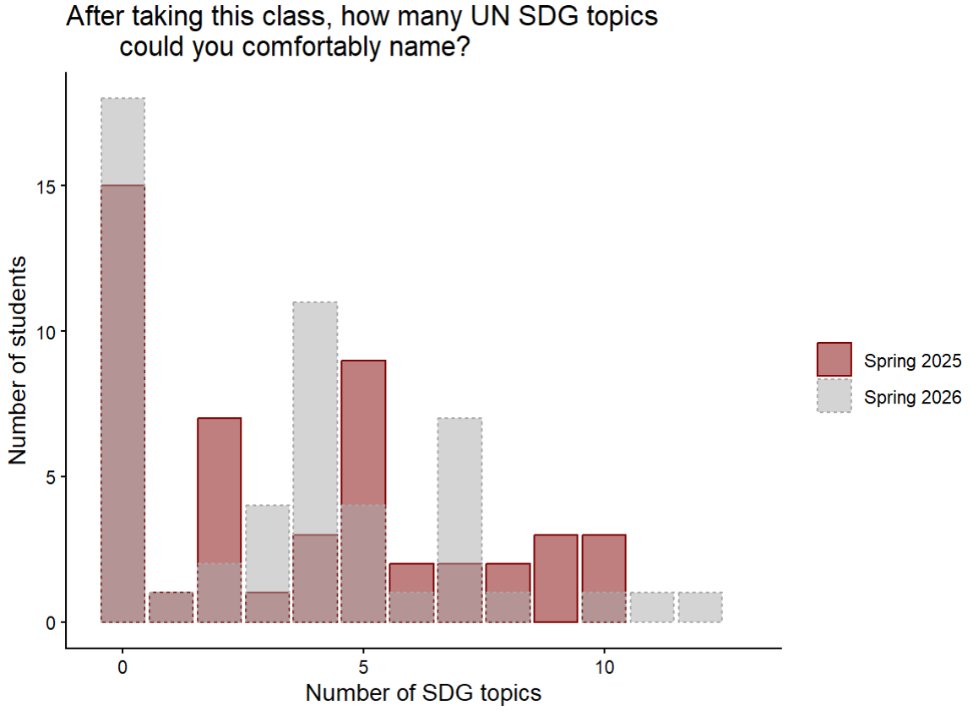
Student Survey: Sustainability knowledge
Around half of the students had not seen sustainability in a previous course. (A similar proportion had not heard of SDGs previously.)
More than half – 69.6% – can name 2+ SDG topics after MA223.

Slide 30
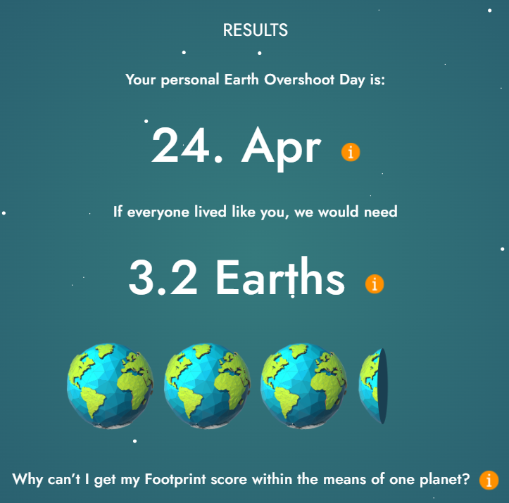
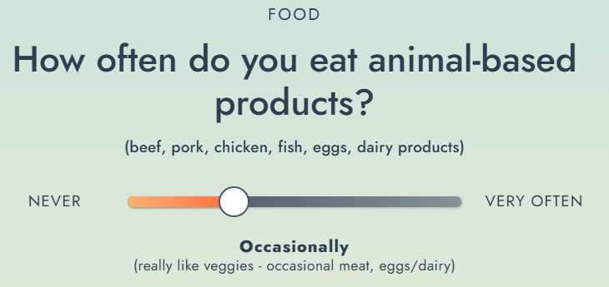
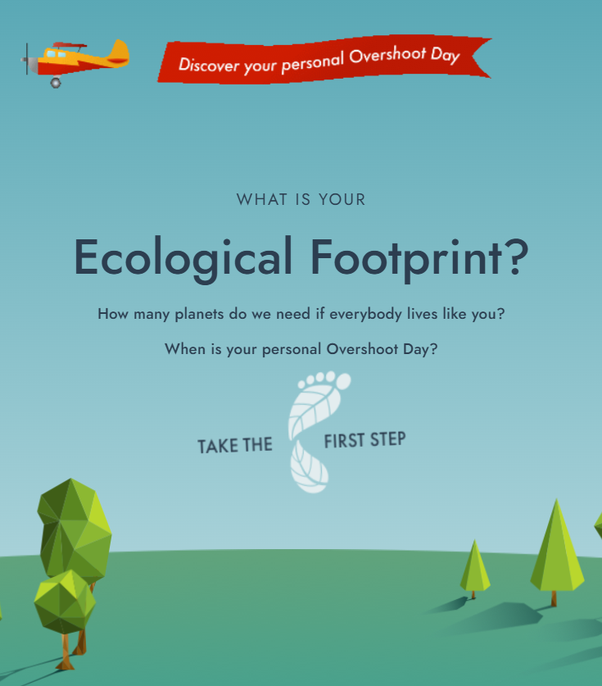
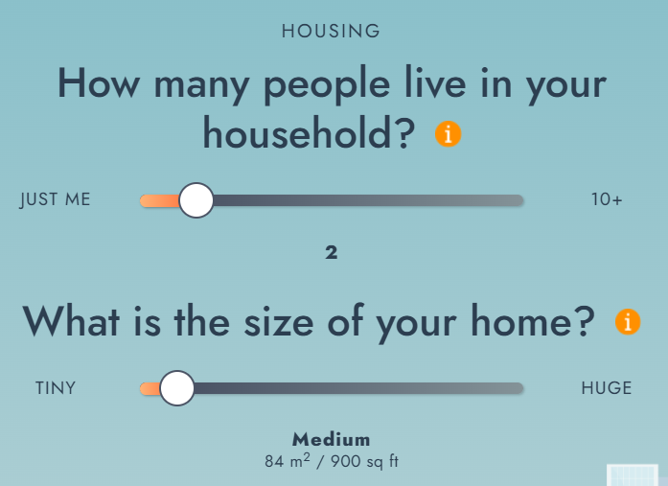
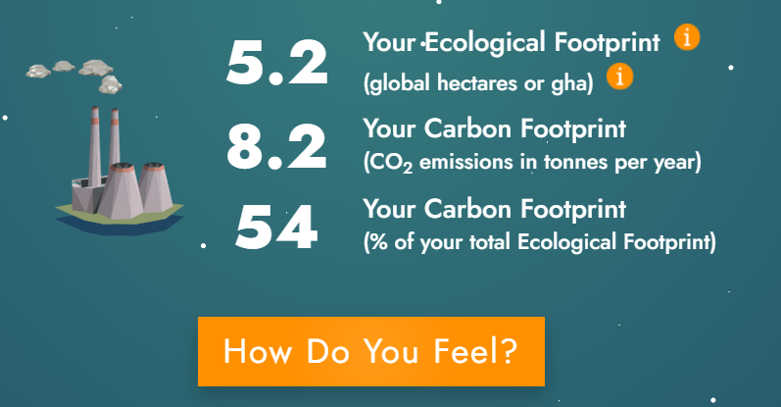
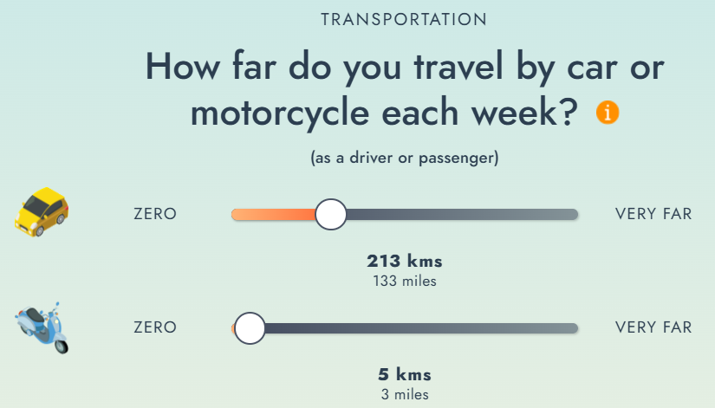
Student Survey: Favorite activity
https://www.footprintcalculator.org/home/en
Second favorite activity: SDG 14 with microplastics and coral reef data/studies.

Slide 31
Discussion: Bringing sustainability into mathematics

Slide 32
What’s going well for me
Students actively engage with peers
Relaxed classroom atmosphere
  Course credit does seem to inspire diligent effort.
  Attendance also helps me identify students that might benefit from a direct contact.
Students & I receive quick feedback of comprehension
Students receive additional course resources.
Sustainability: I’ve enjoyed learning more.
Sustainability: I hear more interesting conversation and sometimes get great questions.
Sustainability: Have not experienced many negative student attitudes that could come from “controversial” topics.

Slide 33
Do not edit
How to change the design
What are your thoughts on sustainability in MA? Are there aspects you find exciting? What challenges concern you?
The Slido app must be installed on every computer you’re presenting from

Slide 34
Some of my challenges
Negative perceptions of sustainability concepts (e.g. climate change)
Trying to incorporate interesting applications/context without distracting from the core course content.
Collecting the data and then maintaining it.
Finding data that aren’t aggregates or population-level information.
Basic intro. statistics methods don’t address complexity
Remembering to give content advisory, esp. early on

Slide 35
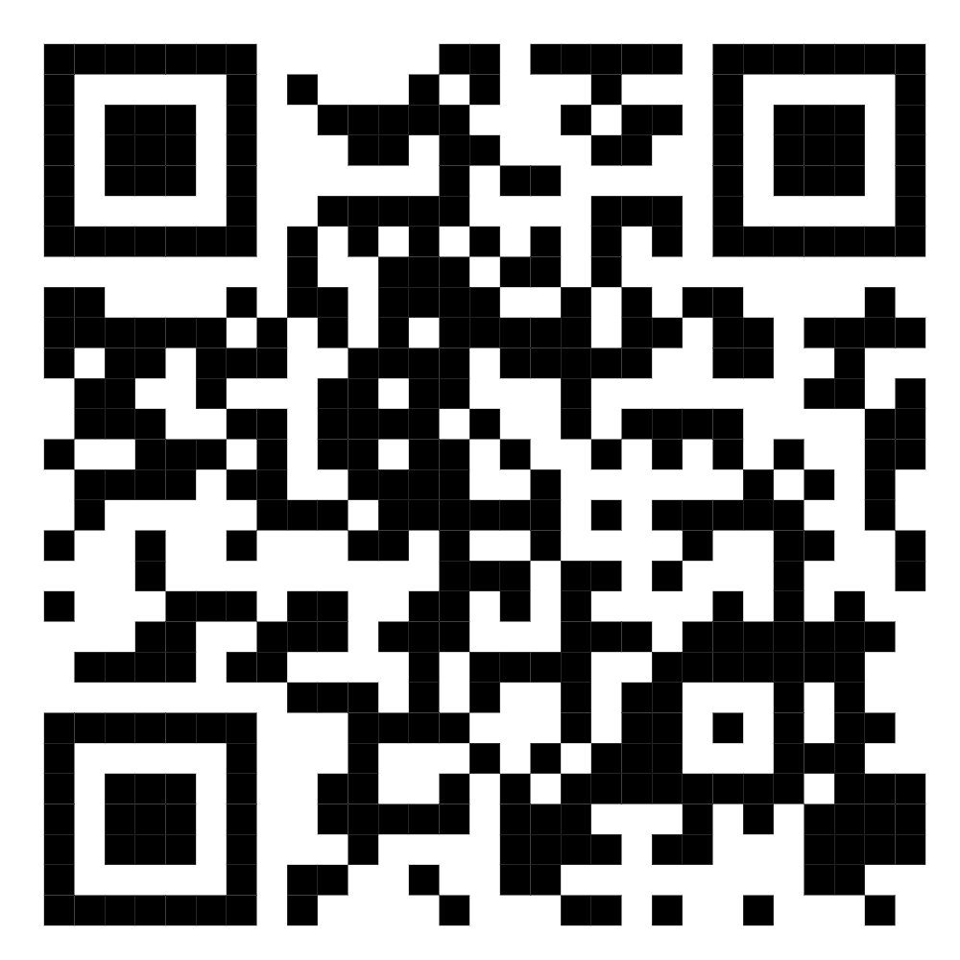
Thank you! – let’s continue the discussion
These slides and other relevant course resources that we discussed are available at: https://meganheyman.github.io/
Contact: Megan Heyman (heyman@rose-hulman.edu)
Thank you to Justin Lambright for organizing/moderating this session and to the Indiana Section of MAA for allowing me to present today.

Slide 36
Additional notes from discussion
A placeholder to jot down ideas, questions that arise during or after the seminar.

